Slide 1
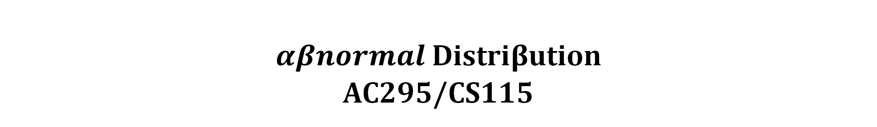
Show, Attend and Tell: Neural Image Caption Generation with Visual Attention
$αβnormal$ Distri$β$ution
AC295/CS115
Notes:
Welcome to the talk on ”Show, Attend and Tell: A Neural Image Caption Generation Algorithm with Visual Attention" by Abnormal Distribution!

Slide 2
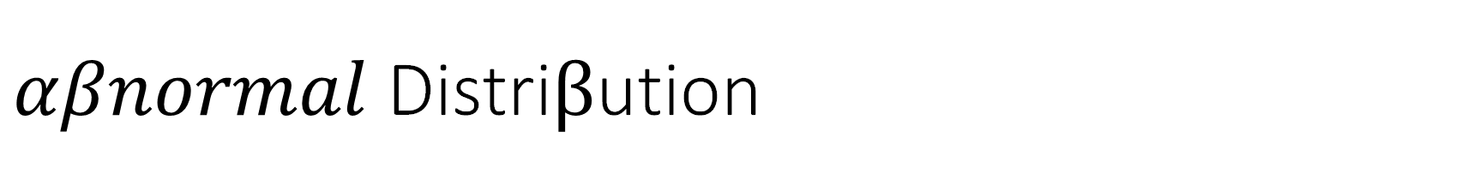
$αβnormal$ Distri$β$ution
Eduardo Peynetti
Jessica Wijaya
Rohit Beri
Stuart Neilson
Notes:
This is us, Eduardo, Jessica, Rohit, and Stuart

Slide 3
Contents
Show, Attend & Tell
Transformers
Q&A
Ed Questions

Slide 4
Show, Attend and Tell
Neural Image Caption Generation with Visual Attention

Slide 5
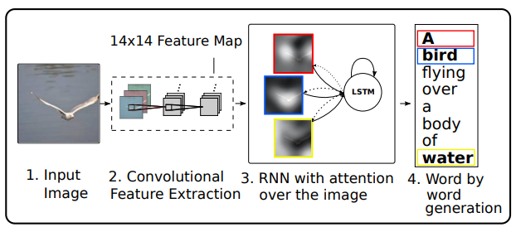
Show, Attend and Tell
Attention-based Model
Automatically learns to describe the content of the images
Two ways to train the model
State-of-the-art performance on three different datasets
Notes:
Here’s an overview of the presentation. The model we are presenting today is a model that automatically generates captions for an image. In other words, it automatically learns to describe the content of the images.
We will return to this summary of the model throughout the presentation, but just as a high-level overview: We have an image which we want to caption. Using transfer learning from an image classification model, we obtain features from a mid-level layer, which have spatial information. Then, using attention, we look for which of these features to pay attention to, and then using an LSTM that receives all of this information: the feature map, the attention context, and the previous captions, we predict the next caption.
There are two ways to train the model, one which is based on hard attention and another on soft attention. We will describe what these concepts mean later in the presentation.
This paper was released in 2016. At the time it achieved state-of-the-art performance in the 3 datasets it used as benchmark: COCO, Flickr8k and Flickr30k.

Slide 6
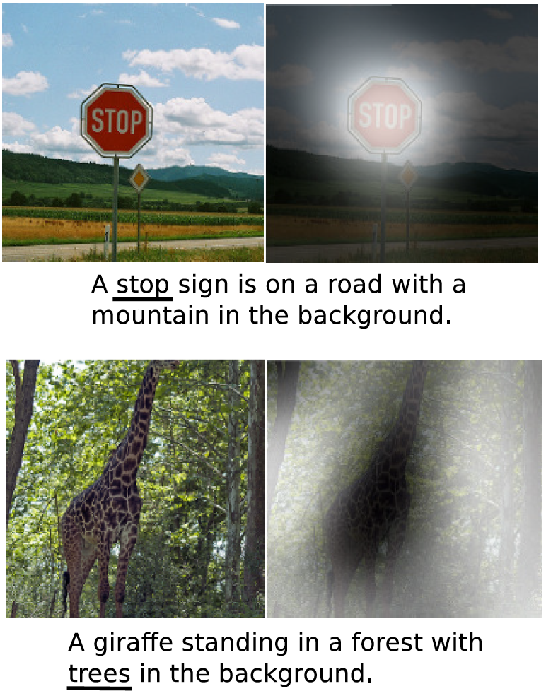
Automatic Caption Generation
At the heart of scene understanding
One of the primary goals of computer vision
Express relationships of objects in a natural language
Mimicking human ability to compress visual information into descriptive language
Notes:
Image captioning is a very important problem in both computer vision and natural language. Not only must caption generation models be powerful enough to detect the objects in the image, but also be able to express their relationships in natural language. Some of these relationships may be abstract. In a way, we can think of image captioning as a translation problem: we are translating an image into words.
Compressing visual information and describing it through language is a basic human ability which would be amazing to mimic through a deep learning model.

Slide 7
Attention
One of the most curious facets of human visual system
Allows for salient features to dynamically come to the forefront as needed
Particularly important when there is lot of clutter
Top-layer representations distill information to most salient objects
Loss of information required for richer and more descriptive captions
Low-level representations can help preserve this information
Two attention-based image caption generators
Soft deterministic attention
Hard stochastic attention
Notes:
Attention is a very powerful skill humans have. You can bring in front of you the information you require while ignoring the rest of the clutter around you. If I’m looking at someone, I can ignore the background or other people or things around that person, and focus on retrieving that person’s name, thinking about their interests, etc. Then at will, I can jump in focus to someone or something completely different.
Many of the things we pay attention to are abstract. It’s not sufficient to be able to detect the objects that are in front of you to explain what’s going on.
The paper proposes using feature representation of the image from a mid-level layer, one which has spatial information. Then we can use attention to find which of these features to focus on. Attention can be used to find more abstract relationships than just detecting objects in an image. For example, we can focus on a weighted average of different features.
There are two mechanisms for attention that can be used: one is soft attention, which is a weighted average of all the features, weighted by the softmax output of the attention layer. Another is hard attention, which is picking one of the features and paying attention to it. We will explain the details of how this works later in the presentation.

Slide 8
Timeline – Image Captioning/Visual Attention
2011
2014
2016
2020
Generating caption templates which were filled in based on the results of object detections and attribute discovery
First retrieving similar captioned images for a large dataset and then modifying these retrieved captions to fit the query
2012
Flurry of Neural Networks based approaches
Show, Attend and Tell
An Image is worth 16 x 16 words
FFNN, RNN, LSTM & R-CNN based approaches
Transformer based architecture for image recognition
Neural image caption generation with visual attention
Notes:
A quick overview of the timeline of image captioning: The first methods used involved a lot of ad-hoc methods and heuristics. They tried to detect objects in images, and attributes such as location, etc. Some of these methods would try to search through a catalogue of images that were already captioned. They would try to find one of these images that resembled our target image, and try to modify the caption to fit it. In general, image captioning was considered a very difficult problem.
Then 2014 came, and with the development of neural networks for image classification, as well as the development of recurrent neural networks, a flurry of papers and ideas came out, with better and better results. The first models used the top layer of a convolutional neural network as feature map, and some models attempted to find a joint latent space with which to both detect images and captions. Still, the focus was on detecting objects in the images.
A couple of the contributions of this paper are: Using a mid-level layer that still has spatial information, and using attention on the features instead of trying to detect objects.
This model predates some of the state-of-the-art object detection and image segmentation models we saw in class YOLO. We’ll discuss about some recent developments at the end of the presentation.

Slide 9
Image Caption Generation – Model Overview
Notes:
So again, an overview of the model:
We have an image which we want to caption. Using transfer learning from a convolutional neural network, by the way, they use VGG16 in the paper; we obtain features from a mid-level layer, which has spatial information. Then, using attention, we look for which of these features to pay attention to, and then using an LSTM that receives all of this information: the feature map, the attention context, and the previous captions, the model attempts to tie everything together to predict the next caption.

Slide 10





Encoder – Oxford VGG
Notes:
As I said before, the convolutional network model they use is VGG. They just use the features of the model as it is, without any finetuning. They use the last convolutional feature map before max pooling and dense layers. This is a 14x14x512 feature map, so you have 196 features of dimension 512. Because of the way the VGG convolves the input image, each of these features has a well defined position in the image. It also has summarized each chunk of the image with as much information as possible. Since the weights of the VGG model aren’t trained, you should get the same features for an image every time you run the algorithm.

Slide 11
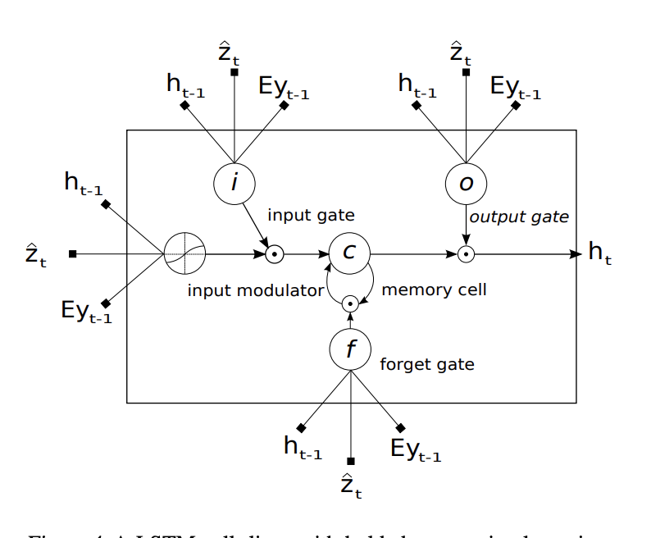
Decoder – LSTM with Attention
Notes:
For the decoder, we are going to use LSTM with attention.

Slide 12
Decoder – LSTM with Attention
LSTM generates one word at every time step, conditioned on:​
Context vector z_{t}
Previous hidden state h_{t-1}
Previously generated word y_{t-1​}
LSTM
$$\left(\begin{matrix}\begin{matrix}i_{t} \\ f_{t}\end{matrix} \\ \begin{matrix}o_{t} \\ g_{t}\end{matrix}\end{matrix}\right)= \left(\begin{matrix}\begin{matrix}σ \\ σ\end{matrix} \\ \begin{matrix}σ \\ tanh\end{matrix}\end{matrix}\right)T_{D+m+n, n}\left(\begin{matrix}{Ey}_{t−1} \\ h_{t−1} \\ {\hat{z}}_{t}\end{matrix}\right)$$
(■8(■8(𝑖_𝑡@𝑓_𝑡 )@■8(𝑜_𝑡@𝑔_𝑡 )))= (■8(■8(𝜎@𝜎)@■8(𝜎@𝑡𝑎𝑛ℎ))) 𝑇_(𝐷+𝑚+𝑛, 𝑛) (■8(〖𝐸𝑦〗_(𝑡−1)@ℎ_(𝑡−1)@𝑧 ̂_𝑡 ))
$$c_{t}= f_{t}⊙c_{t−1}+ i_{t}⊙g_{t}$$
𝑐_𝑡= 𝑓_𝑡⊙𝑐_(𝑡−1)+ 𝑖_𝑡⊙𝑔_𝑡
$$h_{t}= o_{t}⊙{tanh⁡(c}_{t−1})$$
ℎ_𝑡= 𝑜_𝑡⊙〖tanh⁡(𝑐〗_(𝑡−1))
Notes:
This LSTM network is going to be used to generate a word at every time step, given these 3 inputs: the context vector zt, the prev hidden state, and the previous word generated.
The formulation will look like this one on the right
where:
it = input state
ft = forget state
ot = output
gt = input modulator
ht = hidden state
ct = memory
zt ∈ RD = context vector, to capture the visual information associated with a particular input location
E ∈ Rm × K = embedding matrix of dimension m x K
σ and ⨀ be the sigmoid activation & element-wise multiplication respectively

Slide 13
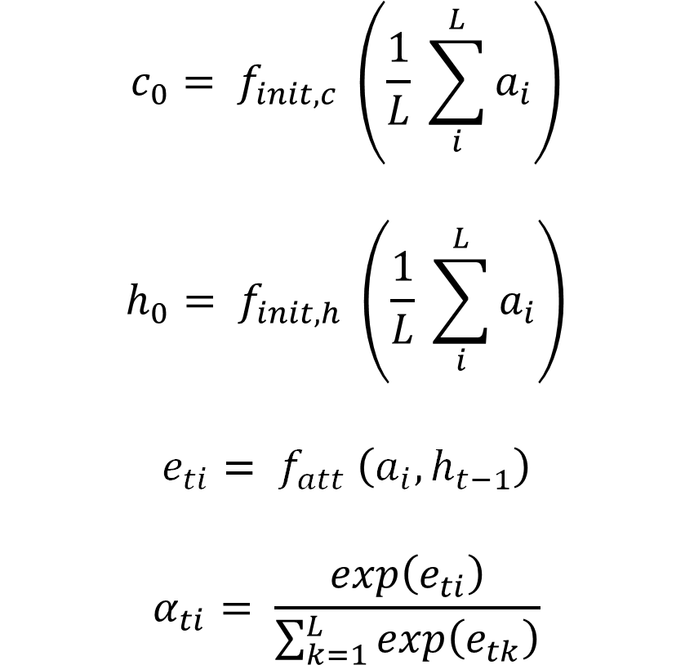
Decoder – LSTM with Attention
$$c_{0}= f_{init, c} \left(\frac{1}{L} \sum_{i}^{L}{a_{i}}\right)$$
$$h_{0}= f_{init, h} \left(\frac{1}{L} \sum_{i}^{L}{a_{i}}\right)$$
$$e_{ti}= f_{att} \left(a_{i}, h_{t−1}\right)$$
$$α_{ti}= \frac{exp\left(e_{ti}\right)}{\sum_{k=1}^{L}{exp\left(e_{tk}\right)}}$$
Initial Memory State and Hidden State
Average of the Annotation Vectors
Weight α_{i} of each Annotation Vector a_{i}
Computed by the attention model f_{att}
MLP conditioned on the h_{t−1}.
Notes:
The initial memory state and hidden state of the LSTM are predicted by an average of the annotation vectors a
Now we are also going to have weight αifor each of the annotation vector ai, which will be computed by the attention model f_att.
We can imagine this weight α as the probability that this particular location is the right place to focus on generating the next word, or the relative importance for each location i in the word prediction. To calculate it, the attention model is gonna use the previous hidden state.
The idea is that “where” the network looks next depends on the sequence of words that has already been generated. This attention model can be developed either using hard attention, or soft attention, which we will cover deeper in the next few slides.

Slide 14
Decoder – LSTM with Attention
Context Vector: $\hat{z_{t}}$
Context Vector: (𝑧_𝑡 ) ̂
Mechanism: $φ$
Mechanism: 𝜙
Deep output layer
Dynamic representation of the relevant part of the image at time t
Probability: Hard attention
$p\left(y_{t} | a, y_{1}^{t−1}\right)∝ e^{(L_{0}(Ey_{t−1}+ L_{h}h_{t}+ L_{z}\hat{z_{t}}))}$
𝒑(𝒚_𝒕│𝒂, 𝒚_𝟏^(𝒕−𝟏) )∝ 𝒆^((𝑳_𝟎 (𝑬𝒚_(𝒕−𝟏)+ 𝑳_𝒉 𝒉_𝒕+ 𝑳_𝒛 (𝒛_𝒕 ) ̂)))
$$\hat{z_{t}}= φ\left(\left\{a_{i}\right\} , \left\{α_{i}\right\}\right)$$
(𝒛_𝒕 ) ̂= 𝝓({𝒂_𝒊 } , {𝜶_𝒊 })
Relative Importance: Soft attention
Probability of the output word
Meaning of $α_{i}$
Meaning of 𝛼_𝑖
Where: $L_{0}∈ℝ^{K × m}, L_{h}∈ℝ^{m × n}, L_{z}∈ℝ^{m × D},$ and $E$ are learned parameters
Where: 𝐿_0∈ℝ^(𝐾 × 𝑚), 𝐿_ℎ∈ℝ^(𝑚 × 𝑛), 𝐿_𝑧∈ℝ^(𝑚 × 𝐷), and 𝐸 are learned parameters
Notes:
Once the weights are computed, we can then compute the context vector z, with the φ function.
φ function will return a single vector given the set of annotation vectors a and their corresponding weights α.
The final layer is the deep output layer, which will compute the output word probability y_{t} (given h_{t}, z_{t}, y_{t-1})

Slide 15
Show, Attend & Tell – Architecture
Encoder - Oxford VGG
Decoder
Attention
LSTM
Prediction
Caption
Conv2D: 5 Layers
MaxPooling: 4 Layers
Notes:
This is just the summary of the architecture:
So in the first part, we have the encoder, which is using the VGG architecture consisting of convolutional layers and maxpooling layers.
Next, we'll have the decoder, which is using the LSTM network with attention.
The output will be yt, which is a sequence of words to describe the image (I.e. the caption).

Slide 16
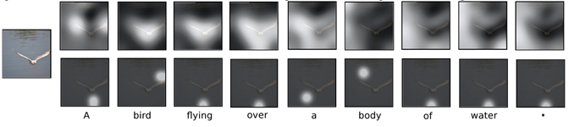
Soft vs Hard Attention
Hard Attention
Soft Attention
Differentiable and amenable to standard backpropagation
$φ$ returns a_{i} at every time step using multinouilli distribution sampling
𝝓 returns a_{i} at every time step using multinouilli distribution sampling
$φ$ returns the expectation of the context vector
𝝓 returns the expectation of the context vector
Monte-Carlo based sampling to compute the gradient
Notes:
Now we are going to discuss 2 different attention mechanism: soft & hard. This is what defines f_att that we discussed earlier.
On a high level, there is 1 most significant distinction between these 2:
- hard attention is stochastic, in that it sees the context vector as a random variable, so we are going to use sampling to solve the problem. As you might have guessed, sampling method is hard, in that the function is not differentiable, so we'll then need to use an approximation algorithm to estimate the gradient.
- soft attention is deterministic, where we just need to calculate the expected value of the context vector. Therefore, the function is smooth and differentiable and we can use standard backpropagation to compute the gradient.

Slide 17
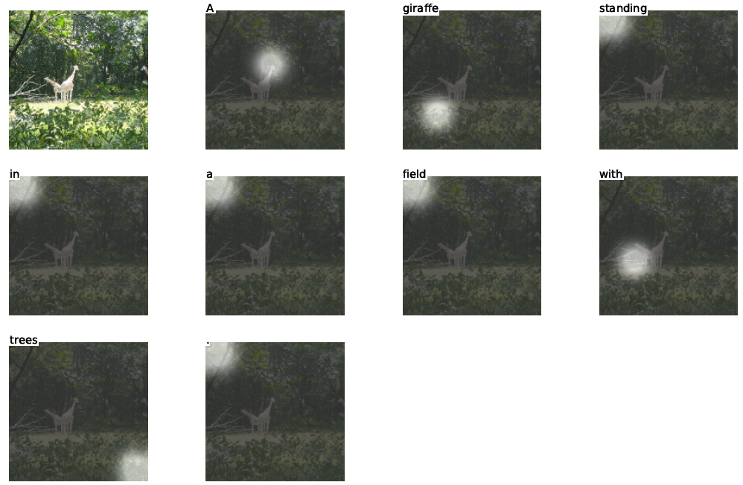
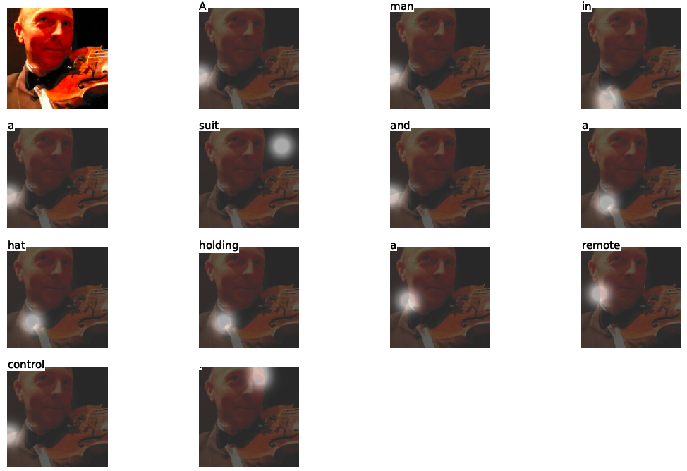
Hard (Stochastic) Attention
Correct Captioning
Incorrect Captioning
Notes:
This shows an example of how hard attention looks at each particular location in the image.

Slide 18
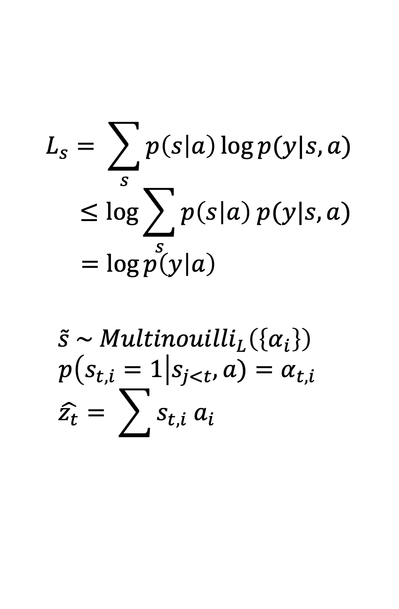
Hard (Stochastic) Attention
Objective function: L_{s}
$$\log{p(y|a)}$$
log⁡〖𝑝(𝑦|𝑎)〗
Hard to compute
Location where the model focuses on when generating the t^{th} word
Latent Variable: s_{t}
Likelihood of observing words y given image feature a
Optimize the variational lower bound instead
$$L_{s}= \sum_{s}{p\left(s | a\right)\log{p(y|s,a)}}$$
$$≤\log{\sum_{s}{p\left(s | a\right) p(y|s,a)}}$$
$$=\log{p\left(y | a\right) }$$
$$\tilde{s} \sim {Multinouilli}_{L}\left(\left\{α_{i}\right\}\right)$$
$$p\left(s_{t, i}=1\right|s_{j<t}, a)=α_{t, i}$$
$$\hat{z_{t}}= \sum{s_{t, i} a_{i}}$$
Notes:
Now, we want to maximize the log likelihood of y (the word sequence), given image feature a. However, this function is hard/almost impossible to compute.
Therefore, we are going to optimize the variational lower bound instead. Now to do this, we are going to introduce the latent variable s. This variable s represent the location of the image that the word is generated for at each time t.
Then, we can set a categorical/multinoulli distribution for s as the proposal distribution, and we can sample from this distribution to calculate p(s|a).
So now, the loss function that we are going to focus on is the sum of p(s|a) * log p(y| s, a). Computing this lower bound function is more doable

Slide 19
Hard (Stochastic) Attention
Optimize L_{s}
Function not differentiable
Sampling Based Approximation
Variance Reduction & Regularization
Final Learning Rule – REINFORCE Learning
$$L_{s}=\log{p\left(y | a\right) }$$
𝑳_𝒔=𝐥𝐨𝐠⁡〖𝒑(𝒚│𝒂) 〗
$$\frac{∂L_{s}}{∂W}= \sum_{s}{p(s|a)\left[\frac{∂\log{p(y|s,a)}}{∂W}+\log{p(y|s,a)} \frac{∂\log{p(s|a)}}{∂W}\right]}$$
(𝝏𝑳_𝒔)/𝝏𝑾= ∑_𝒔▒〖𝒑(𝒔|𝒂)[(𝝏 𝐥𝐨𝐠⁡〖𝒑(𝒚|𝒔,𝒂)〗)/𝝏𝑾+𝐥𝐨𝐠⁡〖𝒑(𝒚|𝒔,𝒂)〗 (𝝏 𝐥𝐨𝐠⁡〖𝒑(𝒔|𝒂)〗)/𝝏𝑾] 〗
$$\frac{∂L_{s}}{∂W}≈ \frac{1}{N}\sum_{n=1}^{N}{\left[\frac{∂\log{p(y|{\tilde{s}}^{n},a)}}{∂W}+\log{p(y|{\tilde{s}}^{n},a)} \frac{∂\log{p({\tilde{s}}^{n}|a)}}{∂W}\right]}$$
(𝝏𝑳_𝒔)/𝝏𝑾≈ 𝟏/𝑵 ∑_(𝒏=𝟏)^𝑵▒[(𝝏 𝐥𝐨𝐠⁡〖𝒑(𝒚|𝒔 ̃^𝒏,𝒂)〗)/𝝏𝑾+𝐥𝐨𝐠⁡〖𝒑(𝒚|𝒔 ̃^𝒏,𝒂)〗 (𝝏 𝐥𝐨𝐠⁡〖𝒑(𝒔 ̃^𝒏 |𝒂)〗)/𝝏𝑾]
Use a moving average baseline
$$\frac{∂L_{s}}{∂W}≈ \frac{1}{N}\sum_{n=1}^{N}{\left[\frac{∂\log{p(y|{\tilde{s}}^{n},a)}}{∂W}+λ_{r}(\log{p\left(y | {\tilde{s}}^{n},a\right)−b)} \frac{∂\log{p\left({\tilde{s}}^{n} | a\right)}}{∂W}+ λ_{e}\frac{∂H[{\tilde{s}}^{n}]}{∂W}\right]}$$
(𝝏𝑳_𝒔)/𝝏𝑾≈ 𝟏/𝑵 ∑_(𝒏=𝟏)^𝑵▒[(𝝏 𝐥𝐨𝐠⁡〖𝒑(𝒚|𝒔 ̃^𝒏,𝒂)〗)/𝝏𝑾+𝝀_𝒓 (𝐥𝐨𝐠⁡〖𝒑(𝒚│𝒔 ̃^𝒏,𝒂)−𝒃)〗 (𝝏 𝐥𝐨𝐠⁡〖𝒑(𝒔 ̃^𝒏│𝒂)〗)/𝝏𝑾+ 𝝀_𝒆 (𝝏𝑯[𝒔 ̃^𝒏])/𝝏𝑾]
Add an entropy term H[s]
Notes:
Now the problem with this method is that the function is not differentiable, so we need to use other mechanism to approximate the gradient.
For this purpose, we are going to use Monte Carlo Based Sampling Approximation. However, this sampling method can be problematic where the variance is large.
So to reduce the variance, we can use moving average baseline or we can add an entropy term H[s]. After doing this, the final learning will look like this final line, which is equivalent to the REINFORCE Learning Rule.

Slide 20
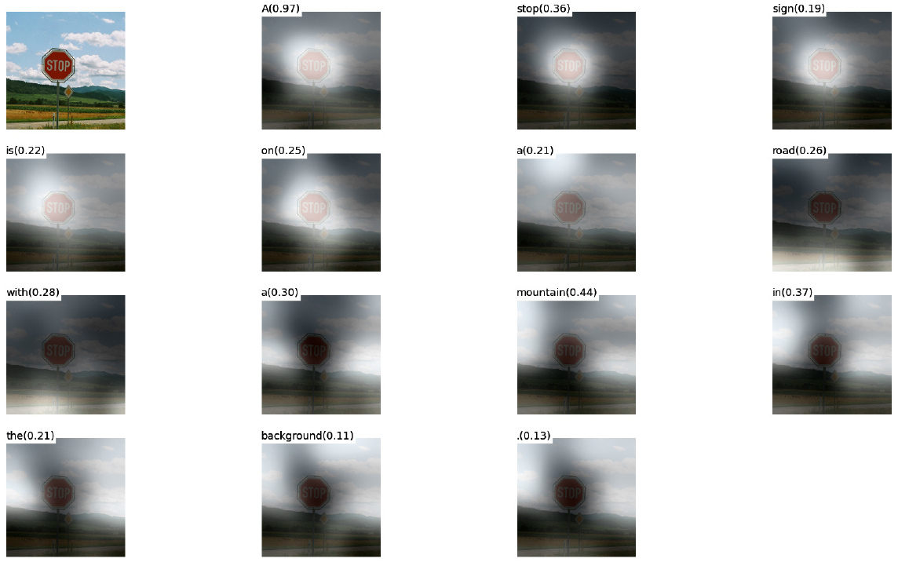
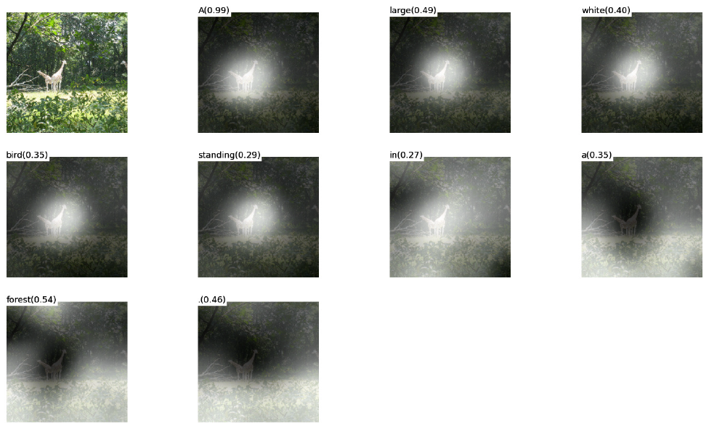
Soft (Deterministic) Attention
Correct Captioning
Incorrect Captioning
Notes:
Let’s look at Soft or Determinisitic attention.
Unlike Hard Attention, Soft Attention may or may not focus on multiple sections of the image to predict the associated word.
We can see above that soft attention may yield more rich description in certain cases as is evident with the Stop Sign image; but in other cases it may be wildly off i.e. assigning tag of birds to a pair of giraffes.

Slide 21
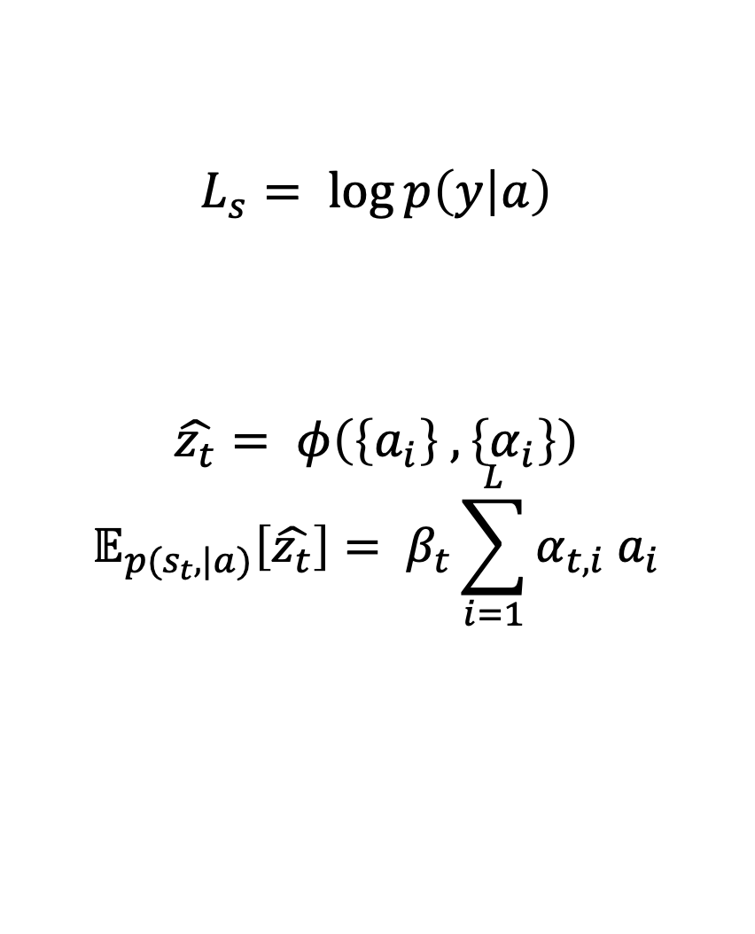
Soft (Deterministic) Attention
Objective function: L_{s}
$$\log{p(y|a)}$$
log⁡〖𝑝(𝑦|𝑎)〗
Model is differentiable and amenable to backpropagation
Directly computes the expectation of the context vector
Context Vector: $\hat{z_{t}}$
Context Vector: (𝑧_𝑡 ) ̂
Likelihood of observing words y given image feature a
$$L_{s}= \log{p\left(y | a\right)}$$
$$\hat{z_{t}}= φ\left(\left\{a_{i}\right\} , \left\{α_{i}\right\}\right)$$
$$𝔼_{p(s_{t},|a)}\left[\hat{z_{t}}\right]= β_{t}\sum_{i=1}^{L}{α_{t, i} a_{i}}$$
Notes:
The objective function of in case of soft attention is exactly the same as earlier. However, in this case it is differentiable and hence amenable to backpropagation.
The context vector is now computed as weighted average of the annotation vectors where the weights are learned by the algorithm.
An additional scalar Beta is also learned as a function of the hidden state.
Deterministic Attention model approximates the marginal likelihood over the attention locations.

Slide 22
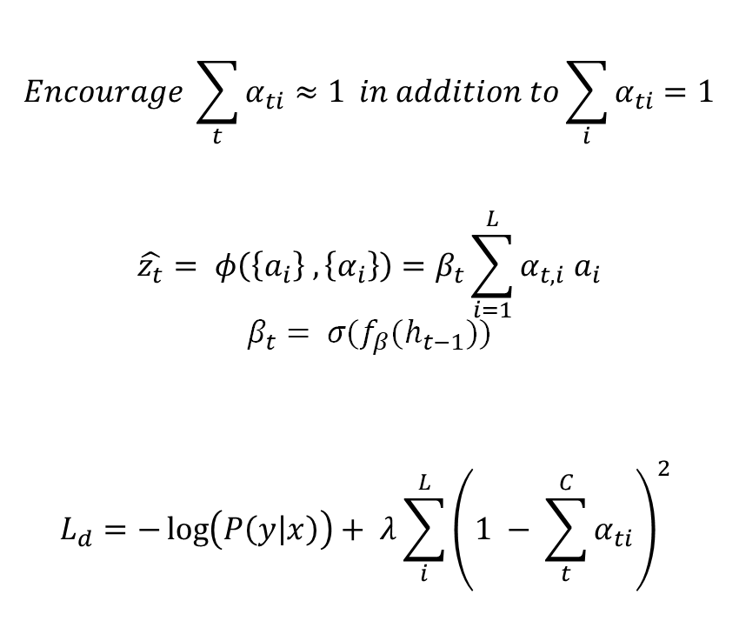
Soft (Deterministic) Attention
Doubly Stochastic Regularization
Forces algorithm to pay equal attention to every part of the image over the course of caption generation
Predicted from previous hidden state h_{t-1} at each time-step t
Model also predicts 𝛽
Minimize penalized negative log-likelihood
Final Objective Function
Emphasis objects in image
$$Encourage \sum_{t}{α_{ti}≈1} in addition to\sum_{i}{α_{ti}=1}$$
$$\hat{z_{t}}= φ\left(\left\{a_{i}\right\} , \left\{α_{i}\right\}\right)=β_{t}\sum_{i=1}^{L}{α_{t, i} a_{i}}$$
$$β_{t}= σ(f_{β}(h_{t−1}))$$
$$L_{d}=−\log\left(P\left(y | x\right)\right)+ λ\sum_{i}^{L}{{\left(1 − \sum_{t}^{C}{α_{ti}}\right)}^{2}}$$
Notes:
For Soft Attention, authors add doubly stochastic regularization to the objective. By definition we have alpha_ti’s sum to 1 across the vectors because of softmax activation. A further constraint to sum alpha_ti’s to 1 across the time steps is added in the objective function.
This Regularization forces algorithm to pay equal attention to every part of the image over the course of caption generation.
Quantitatively: this leads to improvement in BLEU score
And Qualitatively: this leads to more rich and descriptive captions
Additionally, the “Soft Attention” models predicts a scaler $β$ from the previous hidden state h_{t-1} $β$ leads to attention weights being emphasized on objects in the images
The final objective function minimizes the penalized negative log-likelihood where the lambda is a parameter set by cross validation

Slide 23
Datasets
Flickr8k
Flickr30k
Microsoft COCO
8,000 images
5 reference sentences per image
30,000 images
5 reference sentences per image
82,783 images
Some images have >5 reference sentences
Notes:
Now lets look at the experiments conducted by the authors
Authors chose 3 different datasets for experimentation. Flickr8k with 8K images, flicr30k with 30k images and Microsoft coco dataset with 82K+ images
Flickr dataset have 5 reference sentences for each image whereas ms coco some images had more than 5 sentences
Author however limited the reference sentences to 5 per image here as well for consistency
Basic tokenization was used for all three datasets for consistency
Fixed vocabulary size of 10,000 words was used

Slide 24
Training
Optimizers
Flickr8k
Flickr30k & MS COCO
BLEU
Early stopping on BLEU
Corr. breakdown between log-likelihood and BLEU
BLEU for model selection
Mini batches of equal length captions to improve speed
Computing Efficiency
Randomly selected caption length
RMSProp
ADAM
Notes:
Lets look at the training parameters.
Attention models (soft and hard) were trained with SGD using adaptive learning rate
RMSProp was used for Flickr8k as it worked best
ADAM (latest release in 2016) was used for Flickr30k/MS COCO datasets
BLEU score also played a role in Regularization apart from Performance Evaluation
Dropout and early stopping based on BLEU scores
Breakdown in correlation btw. validation set log-likelihood and BLEU in later stages of training
Used BLEU scoring for model selection
To improve speed, authors randomly selected a caption. Then formed mini batches comprising of caption with the same length
Use Whetlab for hyperparameter tuning for Flickr8k using soft attention and Theano was used for coding

Slide 25
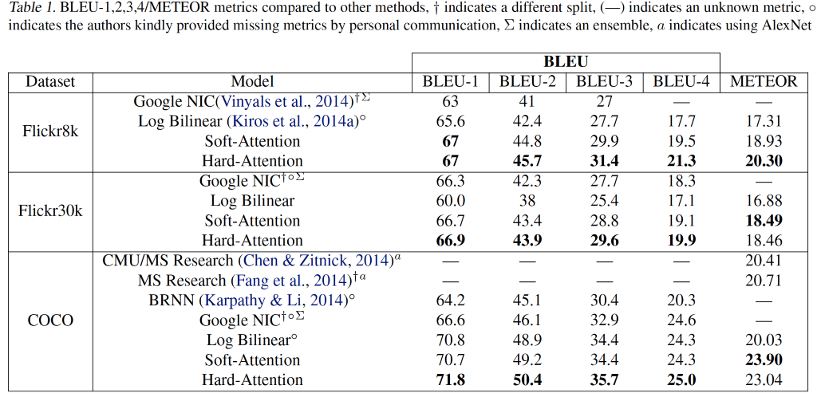
Quantitative Evaluation
Notes:
Finally lets look at the outcomes. Authors compare their models against 5 state of the art image captioning model
For BLEU Scores comparison is made against GoogleNet and Oxford VGG based architectures like
Google NIC (Vinyals et al., 2014)
Log Bilinear (Kiros et al., 2014a)
For METEOR score comparison is made with three models based on AlexNet architecture
CMU/MS Research (Chen & Zitnick, 2014)
MS Research (Fang et al., 2014)
BRNN (Karpathy & Li, 2014)
Authors do not use Ensembling but expect further improvement in performance
Authors fine that their Attention based models are able to beat State of the Art Models across all three datasets.
Hard attention outperforms Soft Attention in most of the cases in BLUE Score but underperforms when comparing METEOR score
Big Boost in METEOR performance is likely due to:
Regularization techniques
Use of lower-level representation
BLEU
Bilingual Evaluation Understudy (BLEU) is an algorithm for evaluating the quality of machine translation
Ranges between 0 and 1 or 0% and 100%
Uses a modified form of precision to compare a translation against multiple reference translations
Frequently been reported as correlating well with human judgement
However, number of criticisms have been voiced
METEOR
Metric for Evaluation of Translation with Explicit Ordering (METEOR) is a metric for the evaluation of machine translation output
Based on the harmonic mean of unigram precision and recall, with recall weighted higher than precision
Produces good correlation with human judgement at the sentence or segment level
Results have been presented which give correlation of up to 0.964 with human judgement at the corpus level, compared to BLEU's achievement of 0.817
At the sentence level, the maximum correlation with human judgement achieved was 0.403

Slide 26
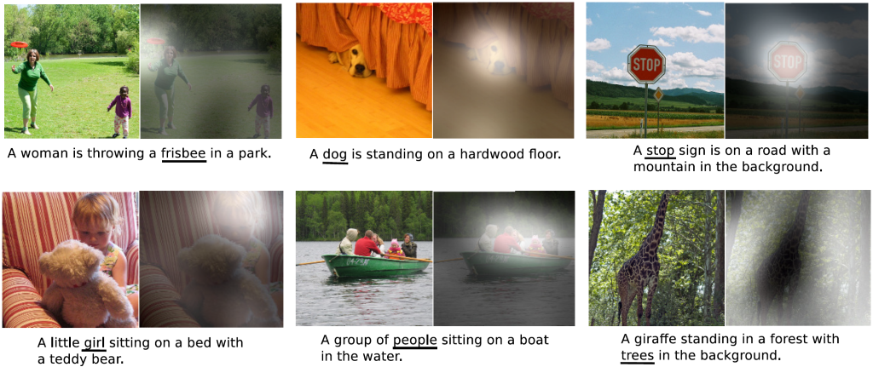
Qualitative Analysis - Visualization
Notes:
It is also important and informative to look at the results from qualitative perspective. One major feature of attention is the visualization. Visualizing the attention component adds an extra layer of interpretability. We notice that Model learns alignment that corresponds to human intuition.
It is possible to exploit visualizations to get an intuition of the reasons for mistakes by algorithm

Slide 27
Conclusion & Future of Image Captioning
Conclusion
“Attention” can help with the model interpretation
Alignments correspond well to human intuition
Future
Transformers
Can we replace CNNs and LSTMs with Transformers?
Notes:
In conclusion Attention-based” approach given state-of-the-art performance on the three datasets.
Learned “attention” can be exploited to give more interpretation for the model’s generation process
Learned alignments correspond very well to human intuition
This paper came out in 2016 and a lot has changed since then. Transformers have come to rule NLP and what we want to explore is that can we replace both CNN and LSTM based architecture with Transformers?
With that lets make a segue into the next part of the presentation

Slide 28
An Image is worth 16 x 16 words
Transformers for Image Recognition at Scale
Conference paper for the 2021 ICLR conference, published on ArXiv last week (an earlier version in which the author names were redacted for blind review was up a few weeks earlier).
Notes:
We will now talk about a second "bonus" article. It's not in the official class readings because it's too new – published just this month. It is called "An Image is Worth 16 by 16 words", by Dosovitskiy et al at Google Brain Team

Slide 29
State of the Art
Natural Language Processing
Image Recognition
FFNN
RNN (LSTM/Bi-LSTM)
LSTM with Attention
Transformer
FFNN
CNN
???
CNN with Attention
Notes:
In Natural Language Processing, we have seen the evolution RNN -> RNN with Attention -> Transformer (Attention Only)
For image processing, the previous article similarly shows the progression from CNN -> CNN with Attention
Can we also go to Transformer only for images, dispensing with convolutions?
This article shows that the answer is yes, introducing the ViT (Vision Transformer) model

Slide 30
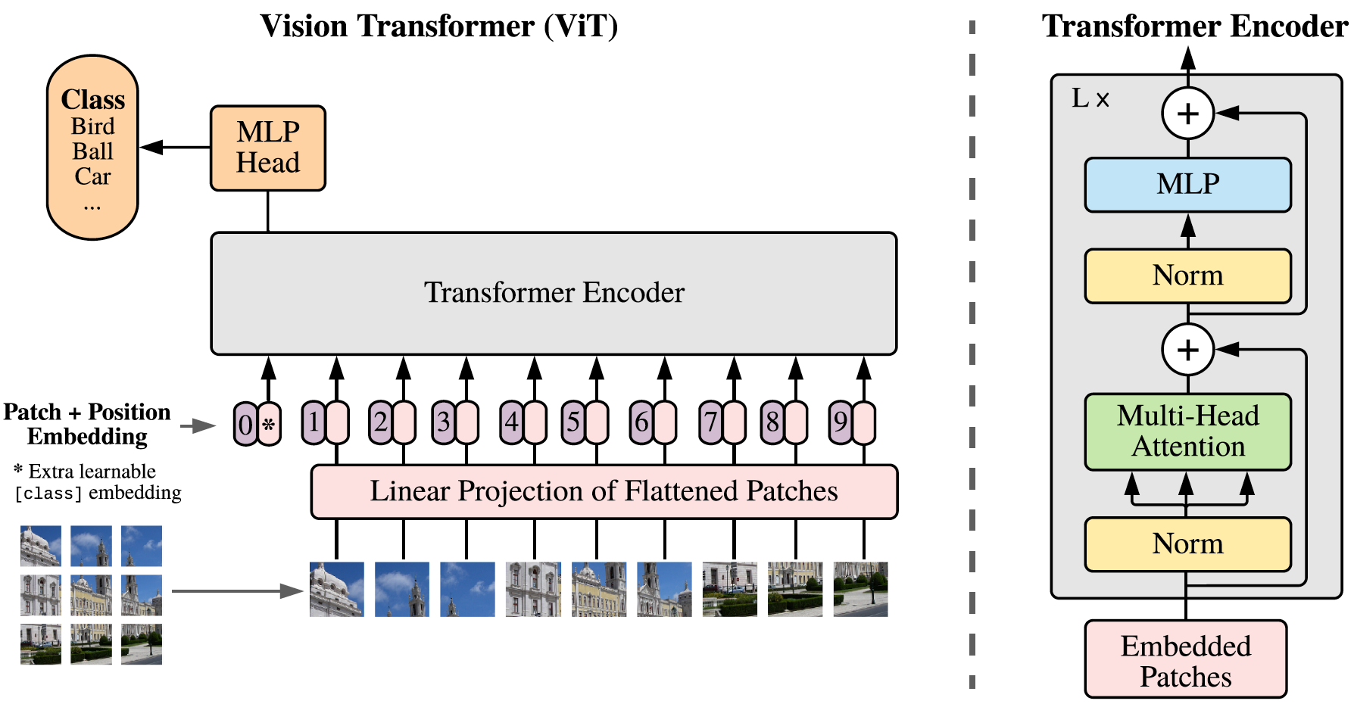
Vision Transformer (ViT)
Notes:
Attention in images relates every pixel to every other pixel, so the computational complexity is O(n squared) where n is the number of pixels (or n to fourth power if you think of n as the image width)
In the previous article, using Convolutional layers reduced this to a reasonable size by making a more compact latent representation
The way the Vision Transformer model handles this challenge is by dividing the image into “patches” of 16x16 pixels
These are flattened then each is combined with a trainable "Position Embedding", then passed into a standard Transformer. Finally there are some feed forward layers.
This architecture is able to take advantage of parallelization in the calculations.

Slide 31
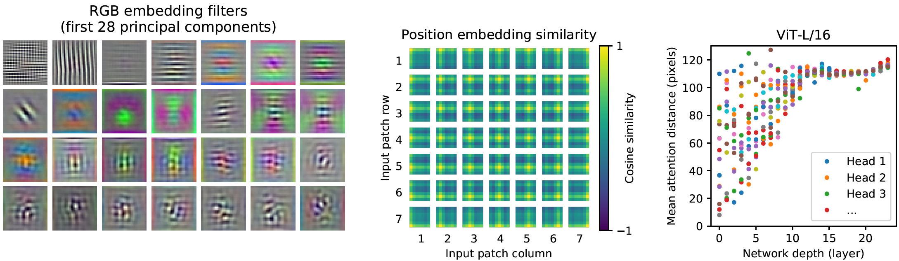
ViT: Learning similar features as CNN
Notes:
These visualizations from the article indicate that this transformer has a learning process reminiscent of Convolutional filters – moving in layers from small features to larger features. However, the attention distance (shown on the right) covers both small and large distances from the beginning, which should benefit via faster training.

Slide 32
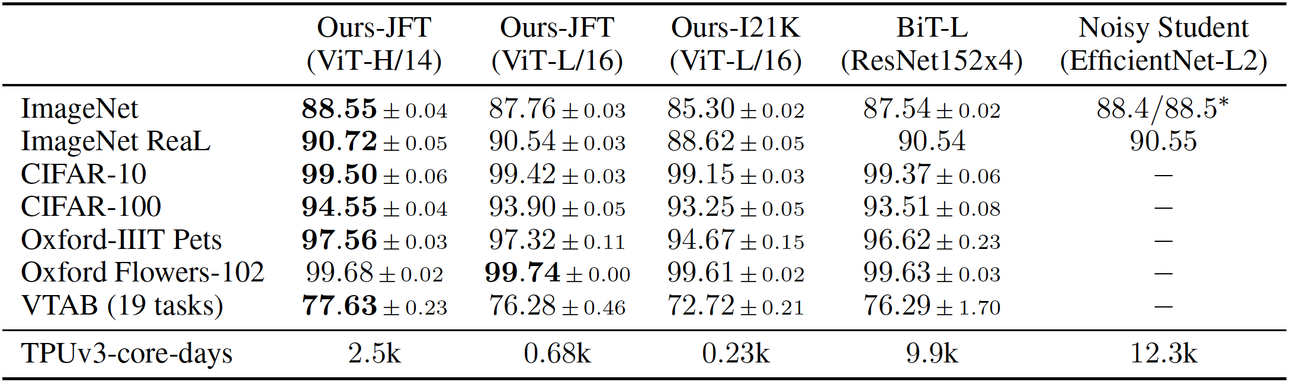
ViT vs SOTA - Performance
Notes:
The model demonstrates state-of-the-art accuracy in several benchmark image classification tasks

Slide 33
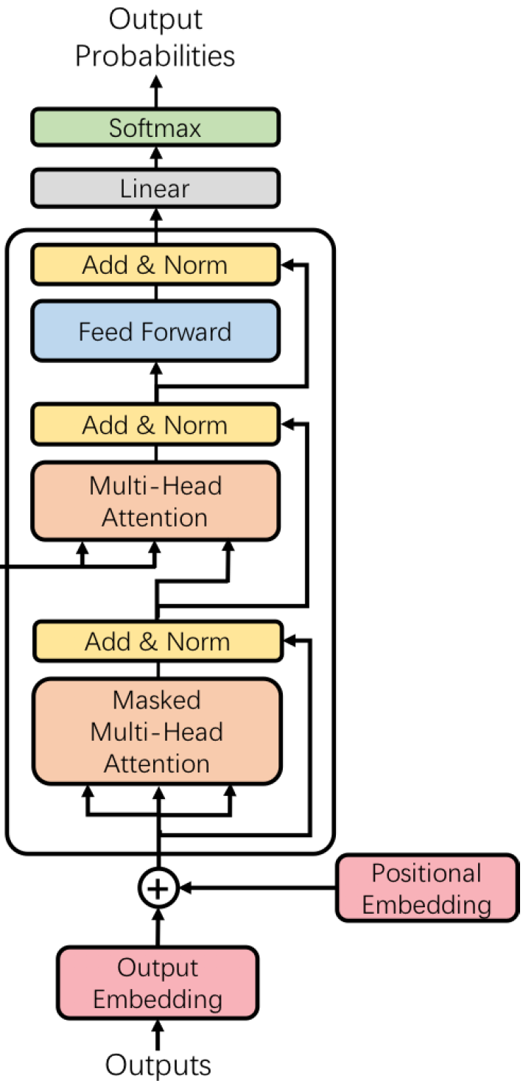
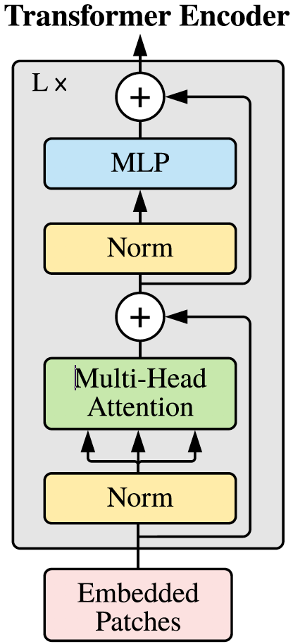
Image Captioning with Transformers?
Notes:
Could we extend this type of model architecture from image classification (as done in this article) to caption generation (as done in the previous article) - where we would need to generate a sequential output?

Slide 34
Ed Questions
Notes:
That concludes our presentation. We will now move on to Q&A. First the question asked on ed -

Slide 35
Cost Function
It's not very clear what kind of cost function is used to evaluate the performance, would be nice to elaborate that.
There is a difference between cost function and the performance evaluation
Cost Function is used for Training is $L_{d}=−\log\left(P\left(y | x\right)\right)+ λ\sum_{i}^{L}{{\left(1 − \sum_{t}^{C}{α_{ti}}\right)}^{2}}$
Cost Function is used for Training is 𝐿_𝑑=−log⁡〖(𝑃(𝑦│𝑥))+ 𝜆∑_𝑖^𝐿▒(1 − ∑_𝑡^𝐶▒𝛼_𝑡𝑖 )^2 〗
For Performance Evaluation, authors use 2-different measures:
BLEU: Bilingual Evaluation Understudy
Uses a modified form of precision to compare a translation against multiple reference translations
METEOR: Metric for Evaluation of Translation with Explicit Ordering
Based on the harmonic mean of unigram precision and recall, with recall weighted higher than precision
Notes:
BLEU
Bilingual Evaluation Understudy (BLEU) is an algorithm for evaluating the quality of machine translation
Ranges between 0 and 1 or 0% and 100%
Uses a modified form of precision to compare a translation against multiple reference translations
Frequently been reported as correlating well with human judgement
However, number of criticisms have been voiced
METEOR
Metric for Evaluation of Translation with Explicit Ordering (METEOR) is a metric for the evaluation of machine translation output
Based on the harmonic mean of unigram precision and recall, with recall weighted higher than precision
Produces good correlation with human judgement at the sentence or segment level
Results have been presented which give correlation of up to 0.964 with human judgement at the corpus level, compared to BLEU's achievement of 0.817
At the sentence level, the maximum correlation with human judgement achieved was 0.403

Slide 36
Data Splits
How would you handle/standardize the differences between dataset splits?
Authors use the predefined splits of Flickr8k
For Flickr30k and MS COCO, authors use publicly available splits used in previous work i.e. Karpathy & Li, 2014
Other splits can be generated, and as per authors, are unlikely to impact the performance scores

Slide 37
Data Preprocessing
How to input and train with text data and image data at the same time? What are the preprocessing needed for constructing data pipeline?
train_captions = []
img_name_vector = []
for image_path in train_image_paths:
caption_list = image_path_to_caption[image_path]
train_captions.extend(caption_list)
img_name_vector.extend([image_path] * len(caption_list))
Notes:
Caption Assignment – Multiple Captions per image – Image Replication
Tokenization
Embedding

Slide 38
Questions Please!

Slide 39
Thanks!

